Slide 1
EE-451 - Image analysis and pattern recognition Project presentation
Group 15:
Tom Mery
Théo Hermann
Gabriel Margaria
02.06.2023
Prof. Jean-Philippe Thiran

Slide 2
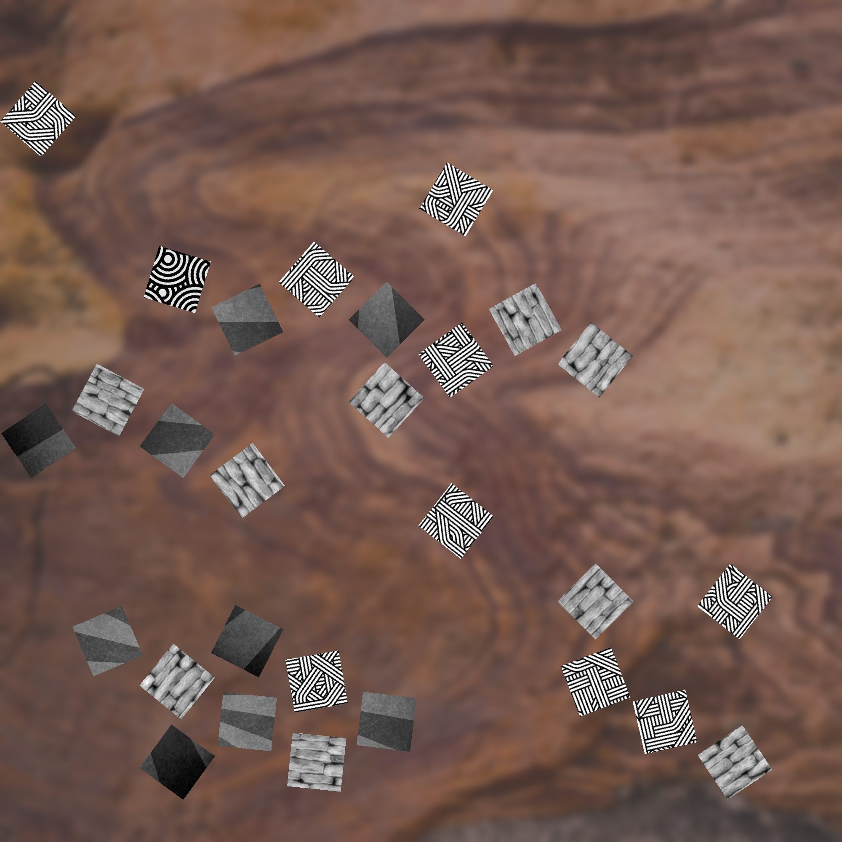
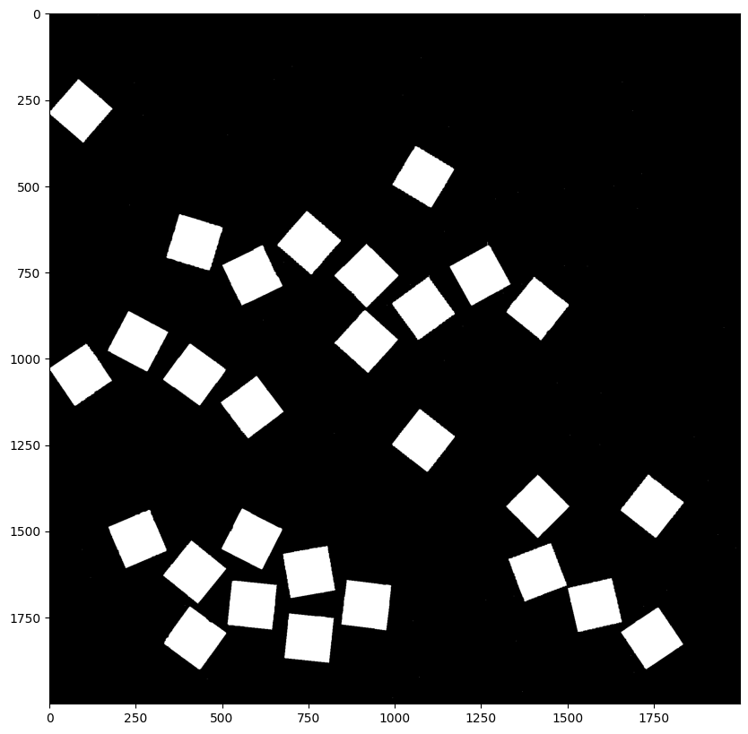
Segmentation
We start with an edge sharpening
Then : use adaptive thresholding to find threshold value according to local distribution.
Finally, morphological operations like removing small holes, closing…
For some images, those steps were enough to get perfectly segmented pieces :

Slide 3
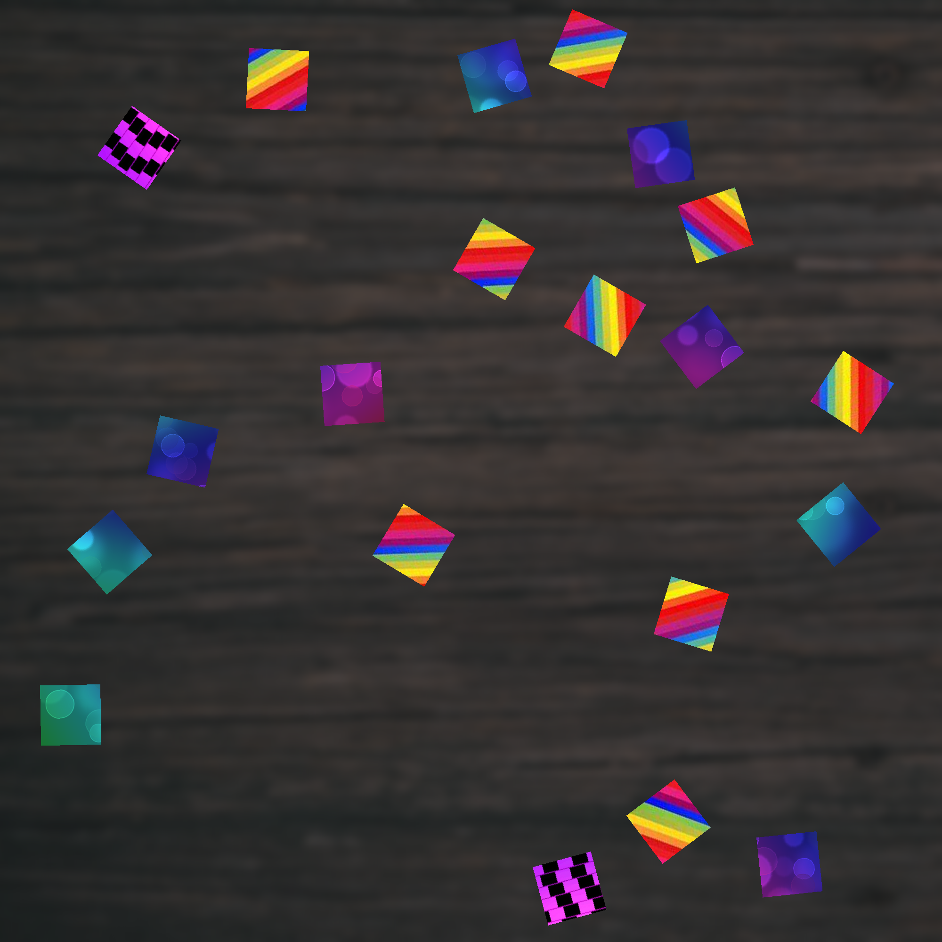
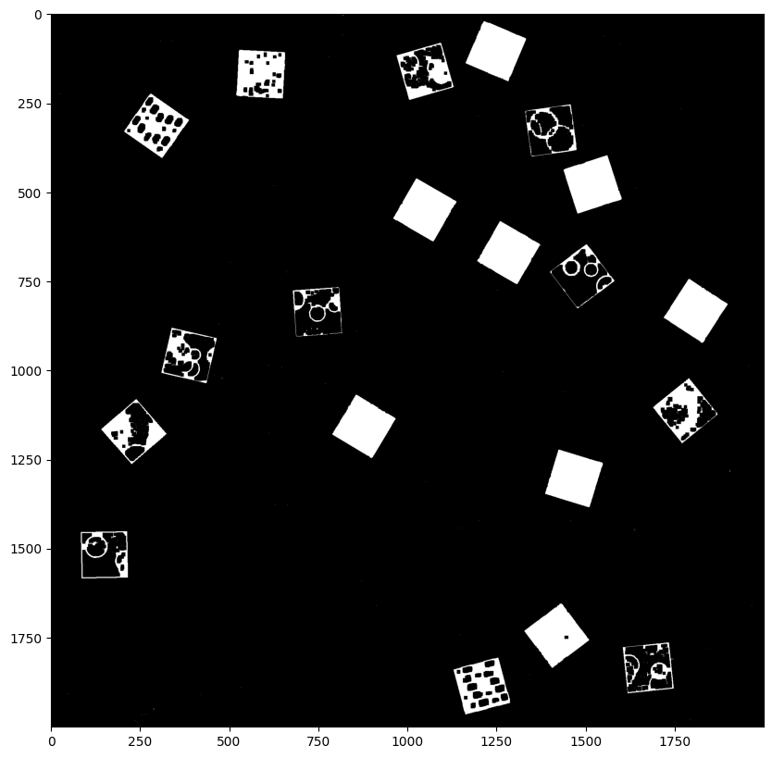
Segmentation
For other images need of additional processing :

Slide 4
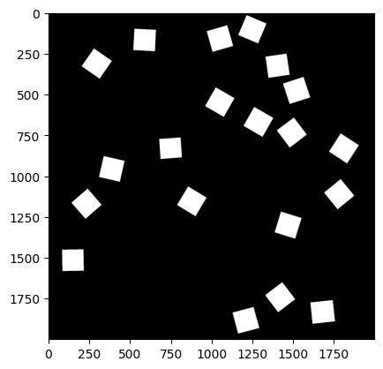
Segmentation : additional steps
We fit a square that has exactly the expected piece size around each object obtained from the previous steps.
We fill those contours completely to obtain the final mask

Slide 5
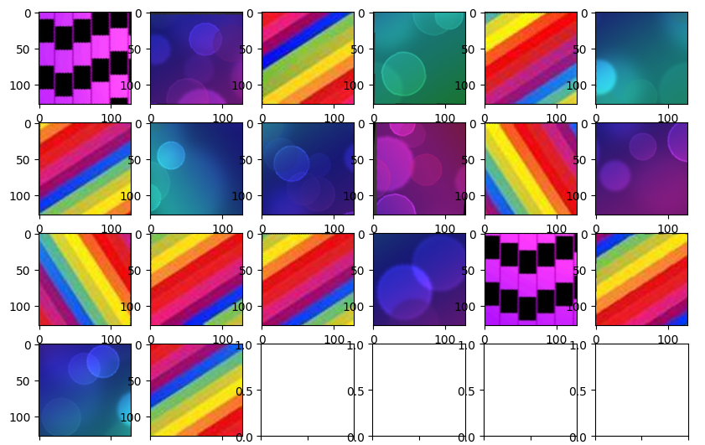
Segmentation : final steps
We then crop each piece thanks to the mask and to the rectangles fitted around each piece
We rotate them to have a list of pieces in the right orientation :

Slide 6
Feature Extraction:
Feature extraction transforms raw data into a reduced and meaningful representation for further analysis.
Our goal here is to extract informative and discriminative features from the data.
Expected properties for good features:
Robustness (noise, lightning variations…)
Invariance (scale, rotation…)
Separability (clear separation between classes, maximize distance in feature space)
Dimensionality reduction
Interpretability of underlying patterns

Slide 7
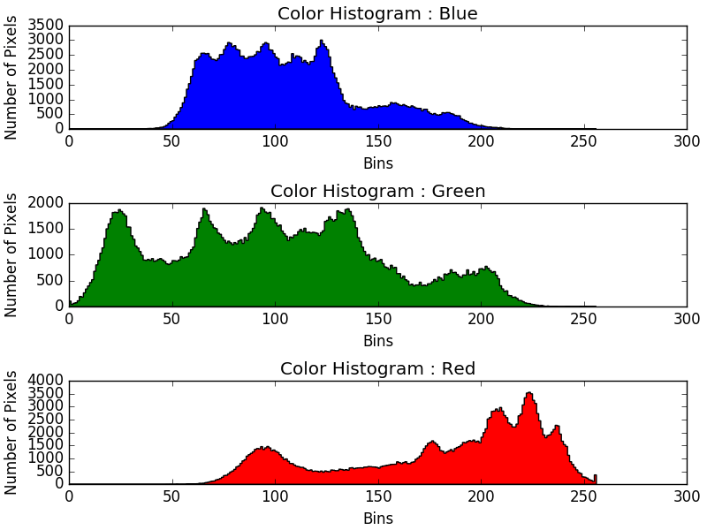
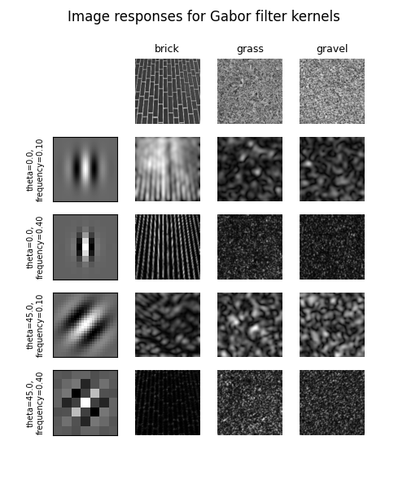
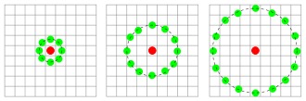
Feature Extraction (Method):
Color Distributions:
RGB histograms: distribution of color intensities in the image. Info about the dominant colors and their frequencies.
Texture Features:
Extracted using Gabor filters, which measure energy and entropy.
Energy indicates the strength of texture patterns, while entropy quantifies their complexity.
Edge Features:
Local Binary Patterns (LBP) histograms computed from the Canny filtered image, capturing local edge variations and patterns.
Neighborhoods examples used to compute LBP

Slide 8
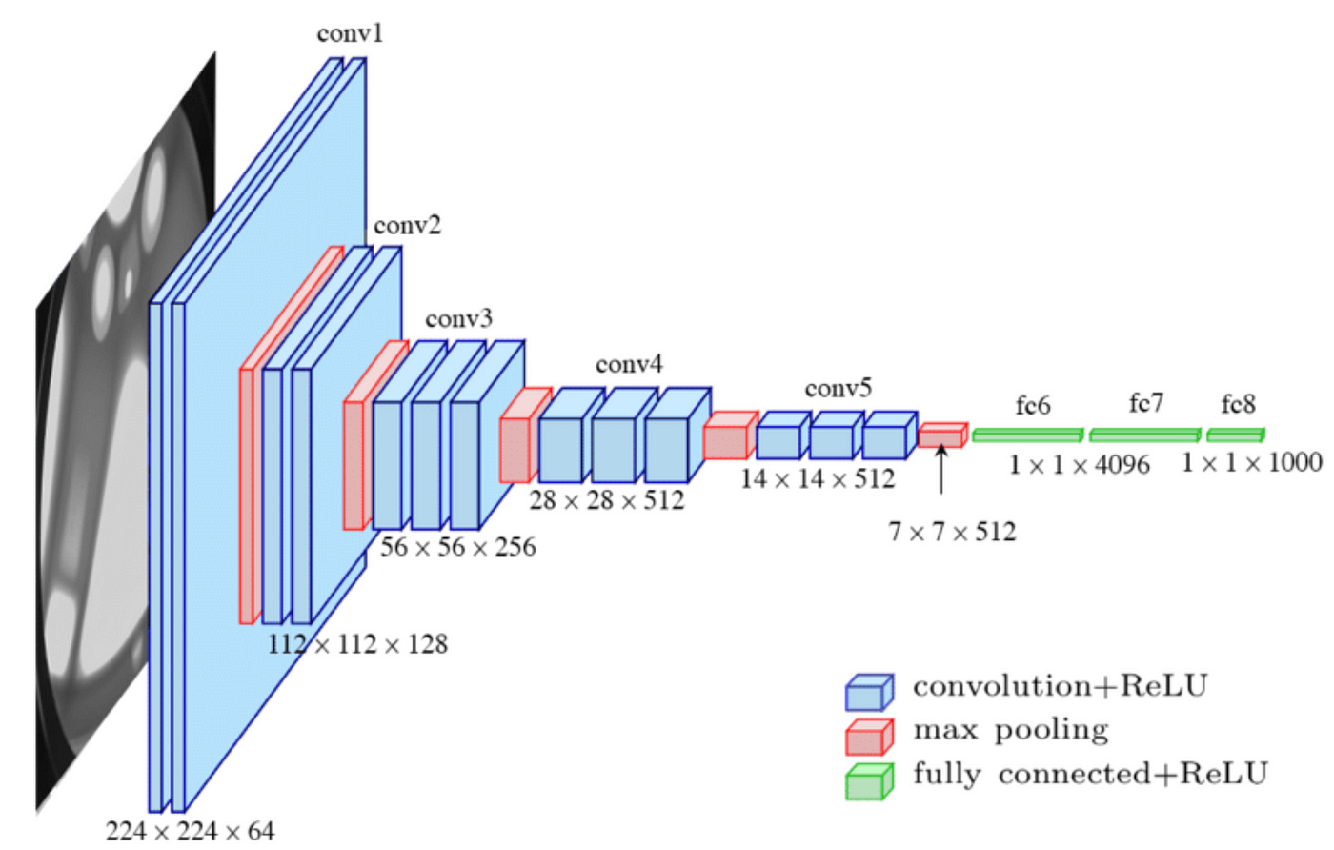
Feature Extraction (Results):
Feature Vector:
Dimensionality Reduction: (128x128x3) => 810
Rich representation of the image:
encompassing color, texture, and edge information
Trade off in the number of features
More features results in a richer representation
But can be longer to compute (Real-Time Constraint)
Especially for the Gabor filter
Interesting other approaches
Pretrained Neural net on ImageNet
Parallel computations
High-dimensional embedding
VGG16 Neural Net

Slide 9
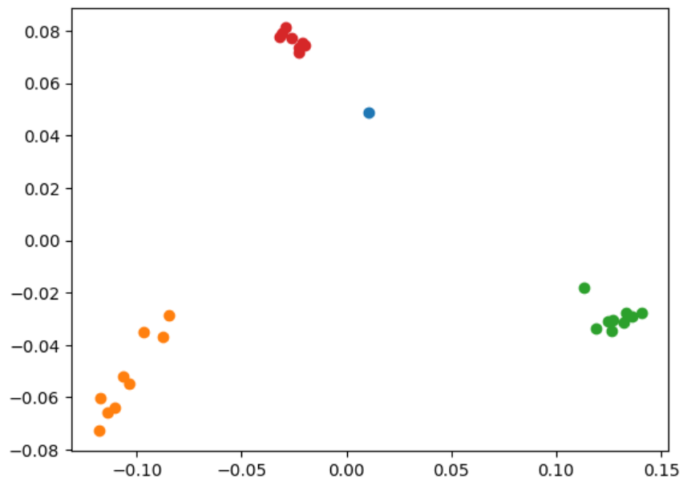
Clustering:
Clustering is an unsupervised learning method for data analysis
Aims to group similar data points together based on similarity.
Here we can see 3 cluster and 1 outlier

Slide 10
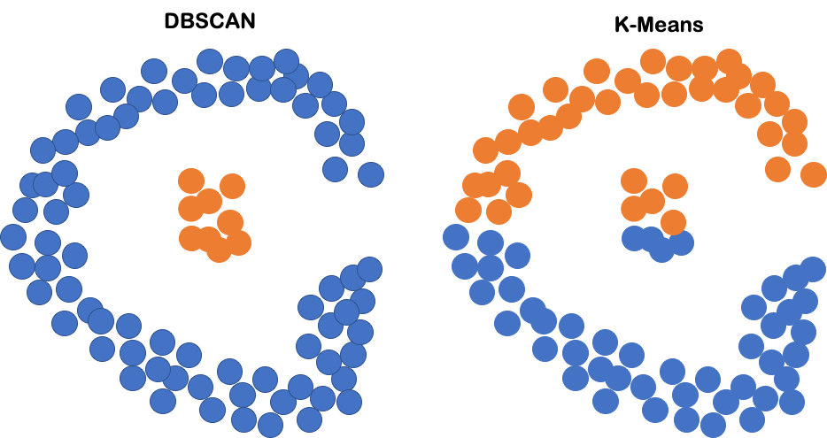
Clustering (Method):
Dimensionality reduction:
Handle high-dimensional feature vectors.
PCA captures the most important variations in the data.
DBScan:
Density-based clustering algorithm
It groups data points that are close to each other and separate regions with low-density points as noise or outliers
K-means:
Partition of the data into a predetermined number of clusters. Assign data points to the nearest centroid and iteratively update the centroid positions.

Slide 11
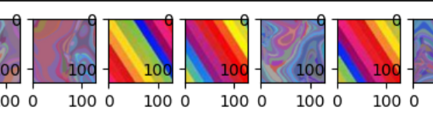
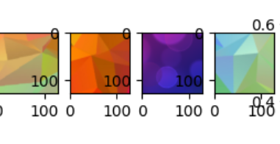
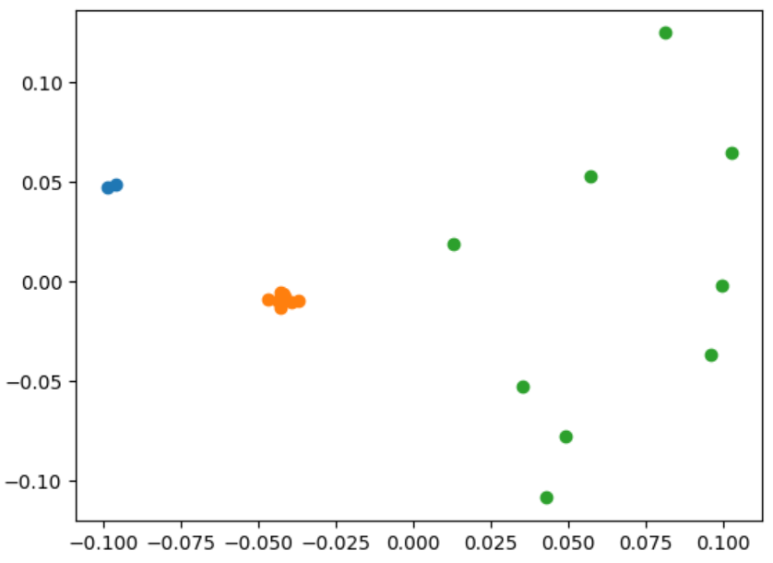
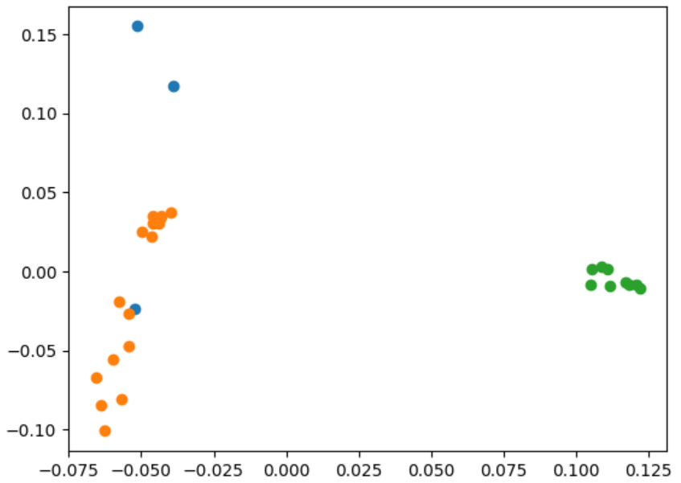
Challenges:
Still have some errors in clustering:
lack of features information (separability)
Unproper tuning of the Clustering hyperparameters
Back and forth between Clustering and feature selection
Particular problem with “gradient” colored images
Error in clustering:
False outliers detected
Grouped multiple clusters as one
Clustering on PCA features
Reduce false outliers
Loss of information, trouble with spread clusters
Non separable samples
Challenging clustering configurations

Slide 12
Constraint-based clustering post-processing:
Leverage the constraints imposed by the task to improve our clustering performances
Cluster as outlier removal
Multiple Clusters Grouped
Not optimal and could be avoided but still useful in our case!

Slide 13
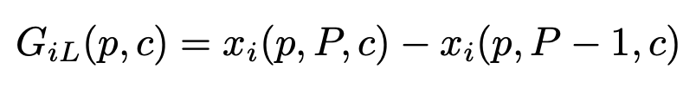
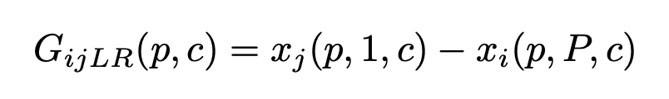
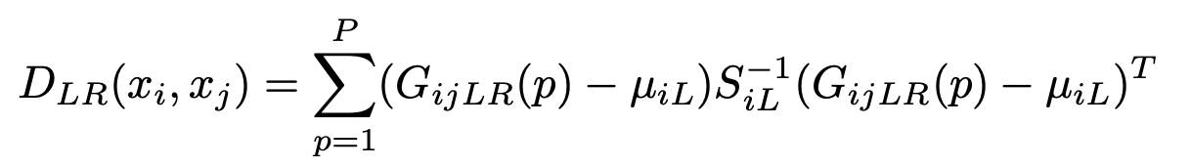
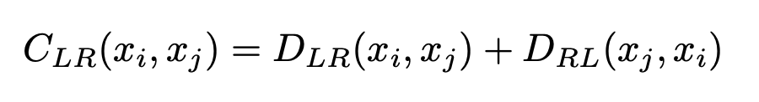
Puzzle Solving: Affinity Metric
Mahalanobis Gradient Compatibility [1]: estimate the local gradients near the boundary of a puzzle piece
Intensity changes along right side xi:
Gradient from right xi to left xj:
3x3 cov of GiL
Compatibility from xi to xj:
Mean of GiL
[1] A. C. Gallagher, Jigsaw puzzles with pieces of unknown orientation, in 2012 IEEE Conference on Computer Vision and Pattern Recognition, Providence, RI, USA, June 16-21, 2012, 2012, pp. 382– 389, http://dx.doi.org/10.1109/CVPR.2012.6247699
Notes:
What is interesting is that it penalize changes in intensity gradients, rather than penalizing changes in intensity.
Want to have similar gradient distribution to the gradient on either side of the boundary.

Slide 14
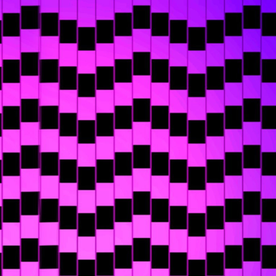
Puzzle Solving: Initialize affinities
Find best match for each edges:
for each pair (p1, p2) of pieces:
for relative position of p2 with respect to p1:
for each relative rotation of p2:
compute affinity of adjacent edges

Slide 15
Puzzle Solving: Initialize affinities
Find best match for each edges:
for each pair (p1, p2) of pieces:
for relative position of p2 with respect to p1:
for each relative rotation of p2:
compute affinity of adjacent edges

Slide 16
Puzzle Solving: Initialize affinities
At the end: for each side of each piece we keep (piece, relative pos, relative rotation) of best match

Slide 17
Puzzle Solving: Create graph
Ideal graph 3x3 puzzle:

Slide 18
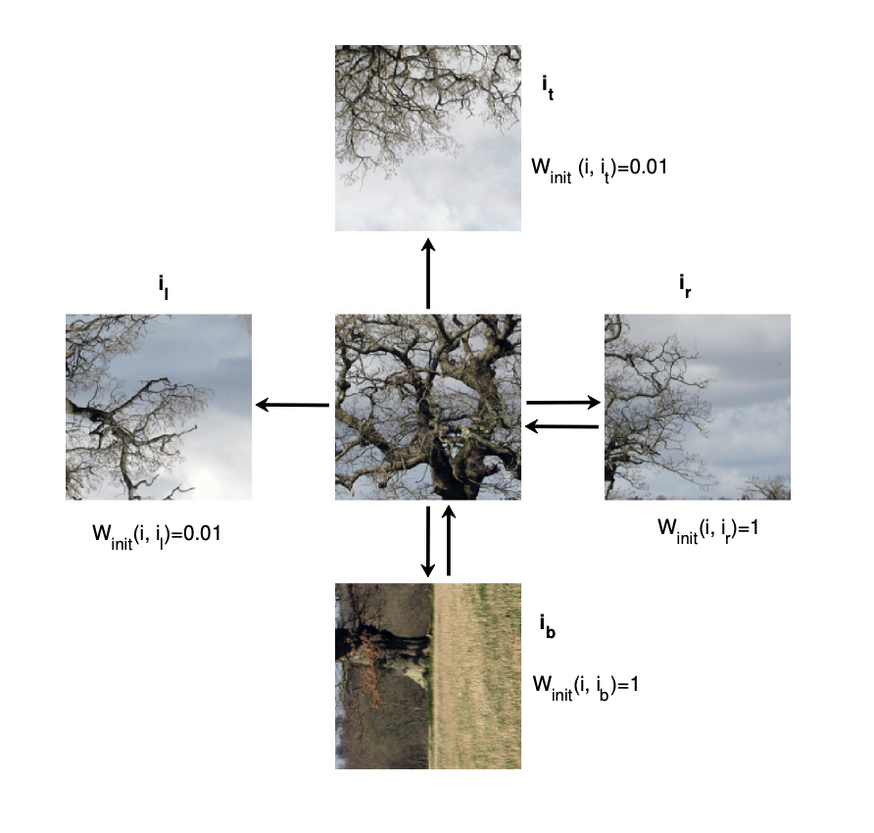
Puzzle Solving: Create graph
Directed graph:
Undirected graph:

Slide 19
Puzzle Solving: 3x3 reconstruction
Ideal graph 3x3 puzzle:
Find center:

Slide 20
Puzzle Solving: 3x3 reconstruction
Ideal graph 3x3 puzzle:
Reconstruct cross,
Apply relative rotation

Slide 21
Puzzle Solving: 3x3 reconstruction
Ideal graph 3x3 puzzle:
Add corners
Apply relative rotation
+

Slide 22
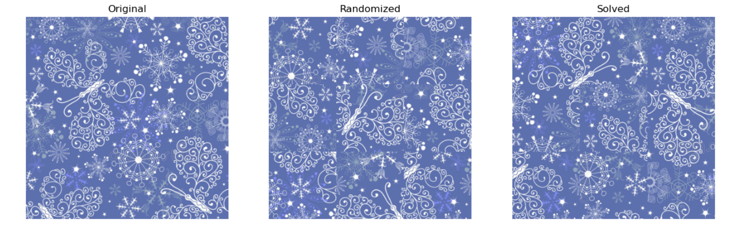
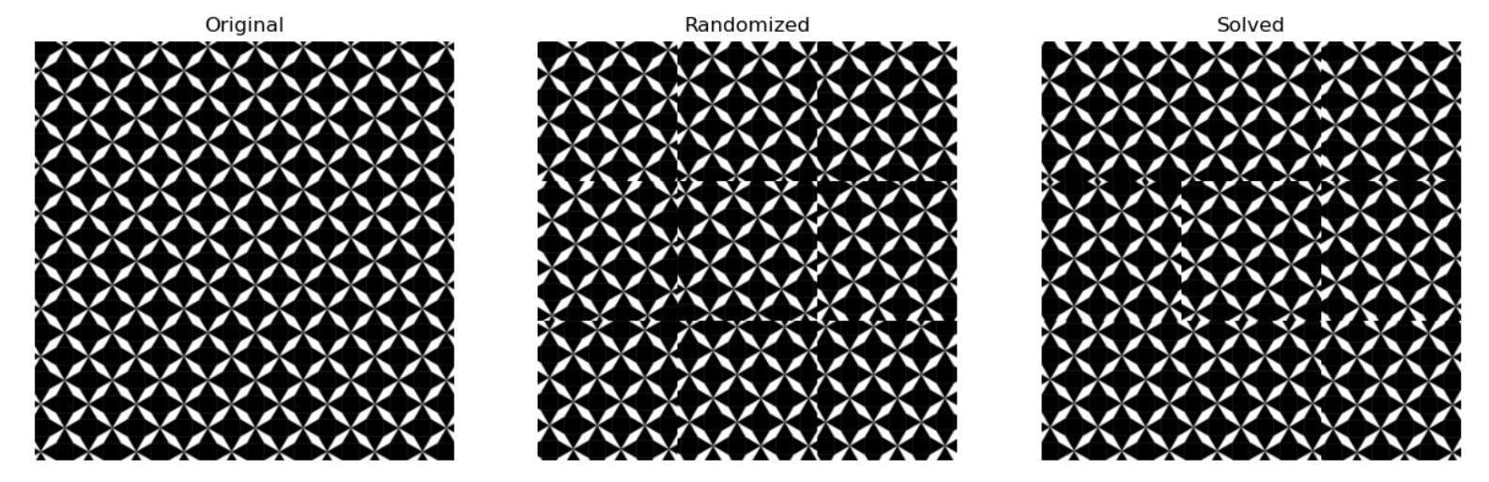
Puzzle Solving: Results on 3x3
14 over 16 perfect (87.5%) solving on training data if perfect segmentation

Slide 23
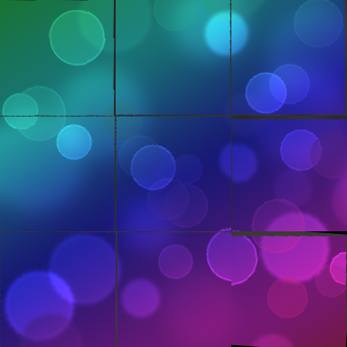
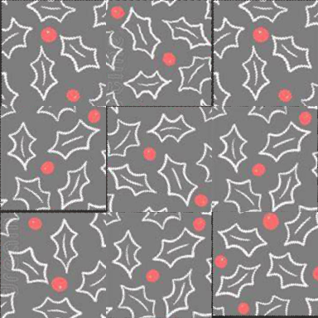
Puzzle Solving: Results on 3x3
In practice …

